Slide 1

CPSC 240 Computer Organization and Assembly Language
First Program
Hello World
Instructor: Yitsen Ku, Ph.D.
Department of Electrical Engineering,
California State University, Fullerton, USA

Slide 2
Open Ubuntu Tuffix on VCL

Slide 3
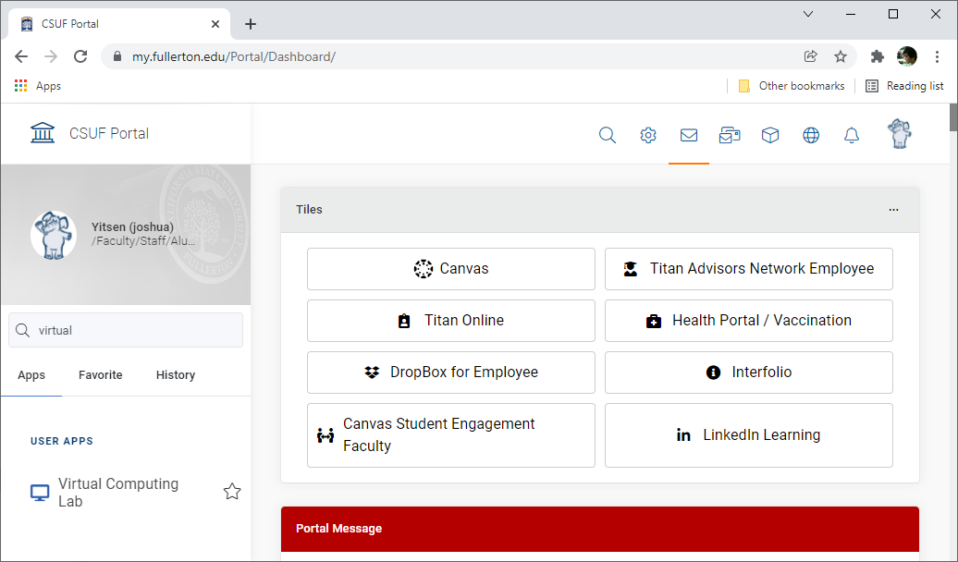
a. Search "Virtual" in Portal, and click "Virtual Computing Lab".

Slide 4
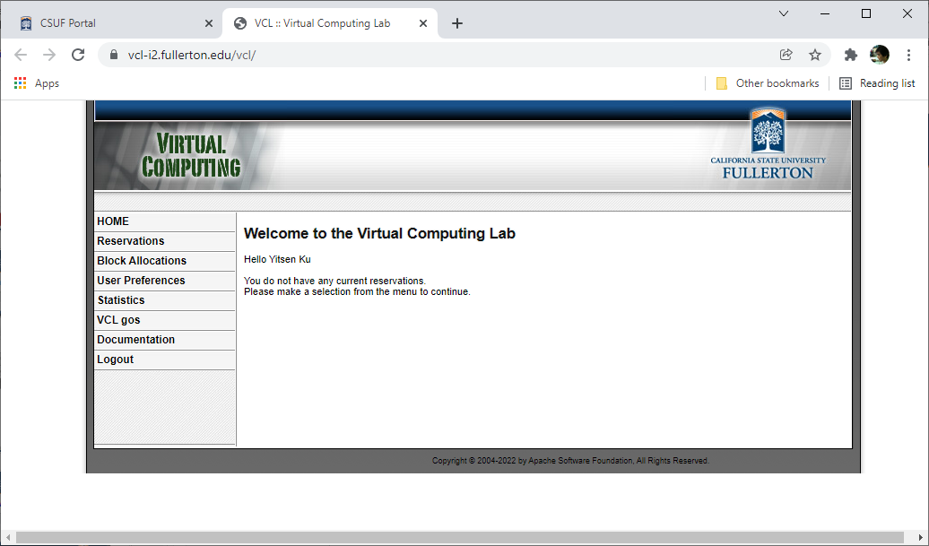
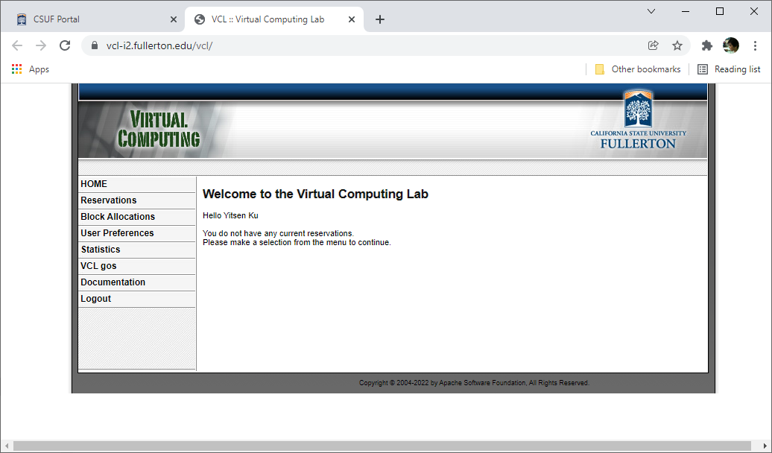
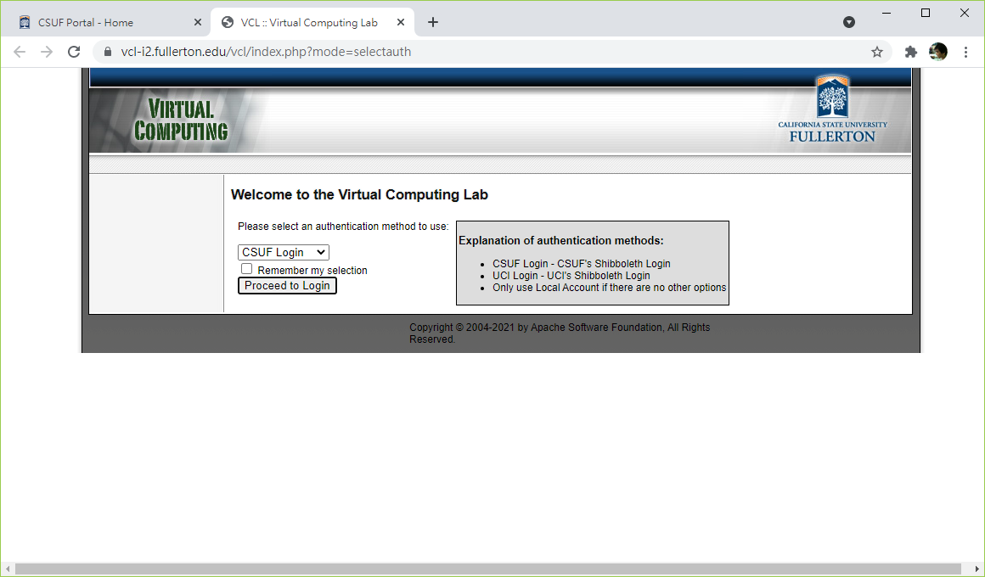
b. Click "Proceed to Login" in the Virtual Computing Lab.

Slide 5
c. Select "Reservations" in the Virtual Computing Lab.

Slide 6
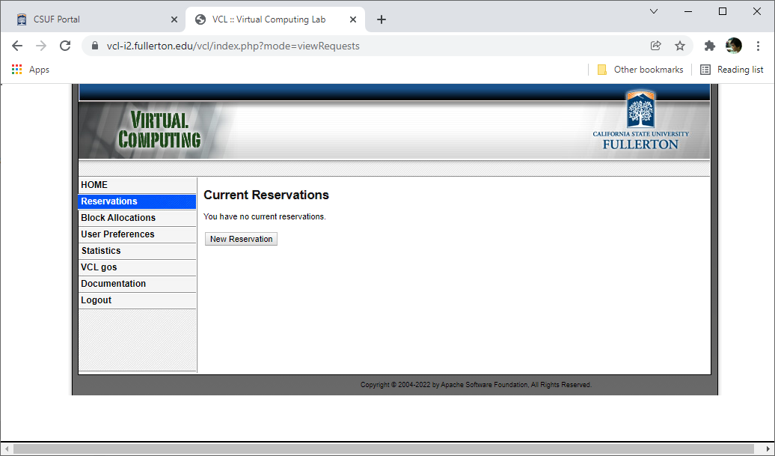
d. Click "New Reservation" button to open New Reservation dialog.

Slide 7
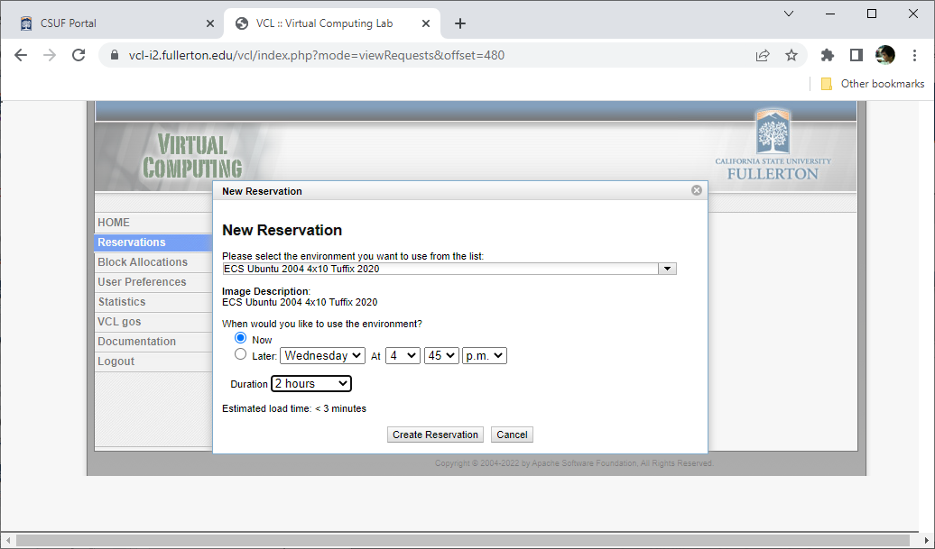
e. Select "ECS Ubuntu 2004 4x10 Tuffix 2020" and select "Duration=1/2/4 hours". Click "Create Reservation" button.

Slide 8
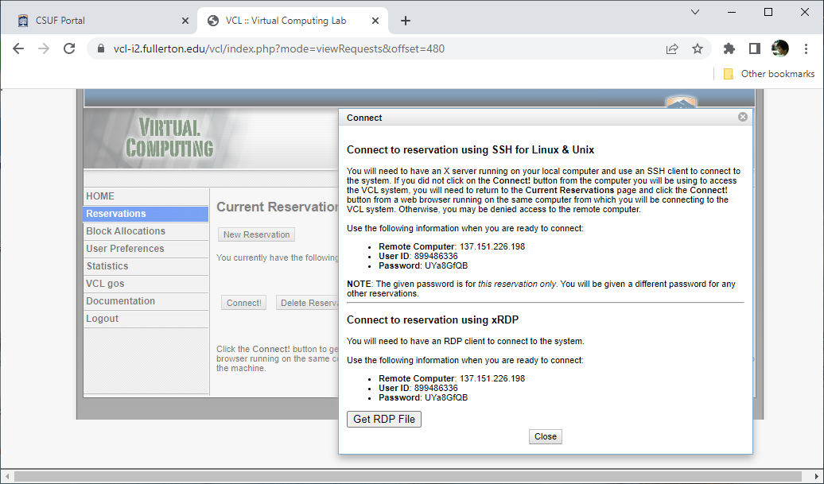
f. Click "Connect!" to open "Connect" dialog.

Slide 9
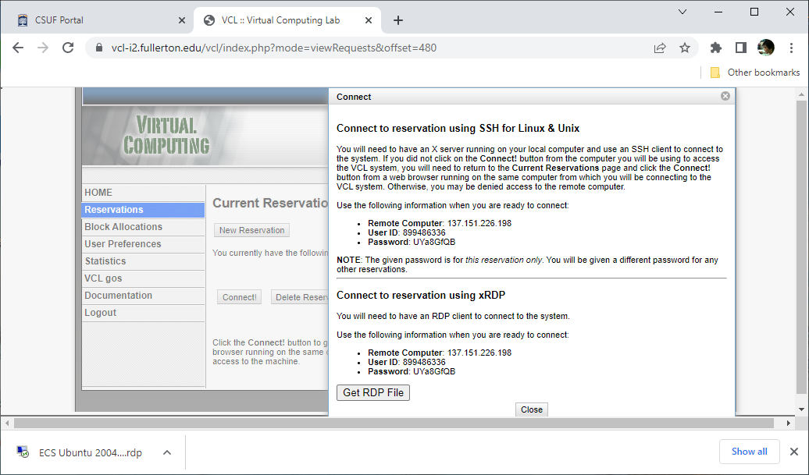
g. Click "Get RDP file" button, and then Click the " ECS Ubuntu 2004 4x10 Tuffix 2020.rdp" file to log in.

Slide 10
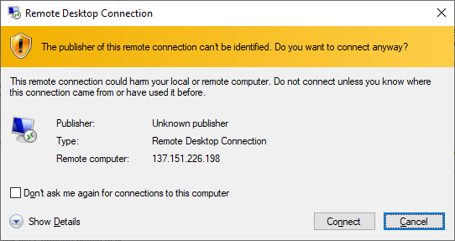
h. Click the "Connect" button to continue.

Slide 11
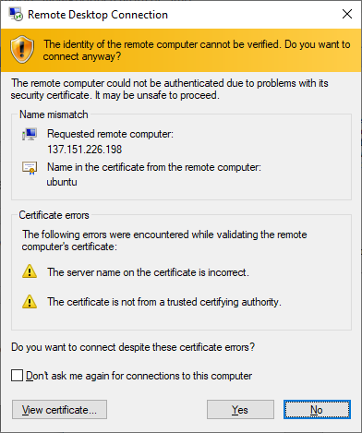
i. Click the "Yes" button to continue.

Slide 12
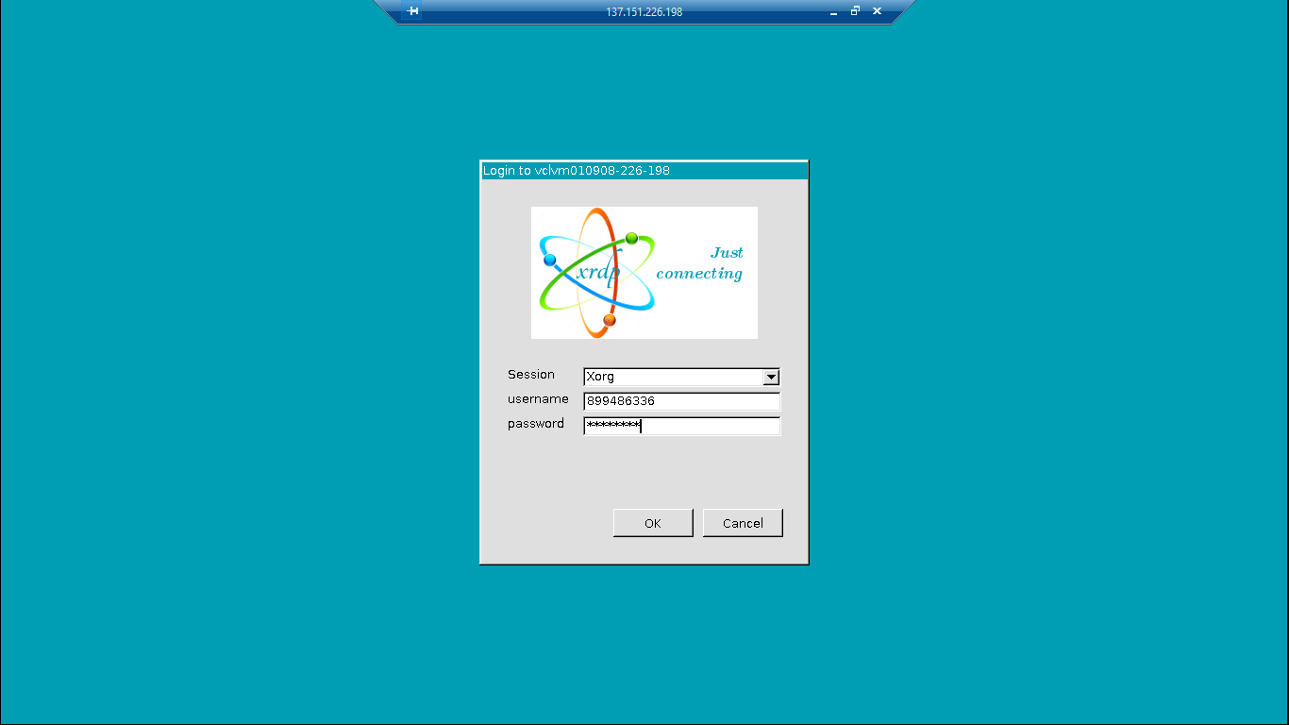
j. Input password and click the "OK" button to continue.

Slide 13
Create New Program

Slide 14
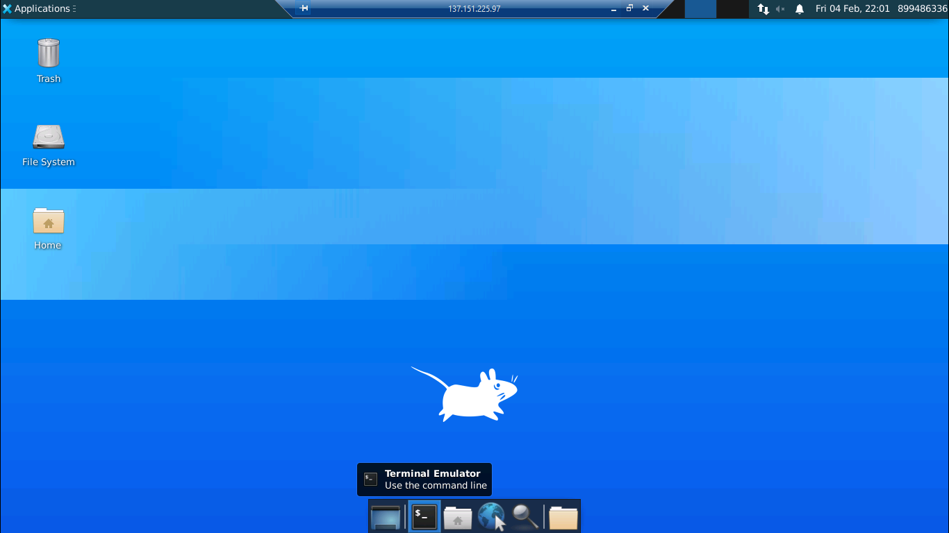
a. Click the "Terminal Emulator" to open the "Terminal Emulator" window.

Slide 15
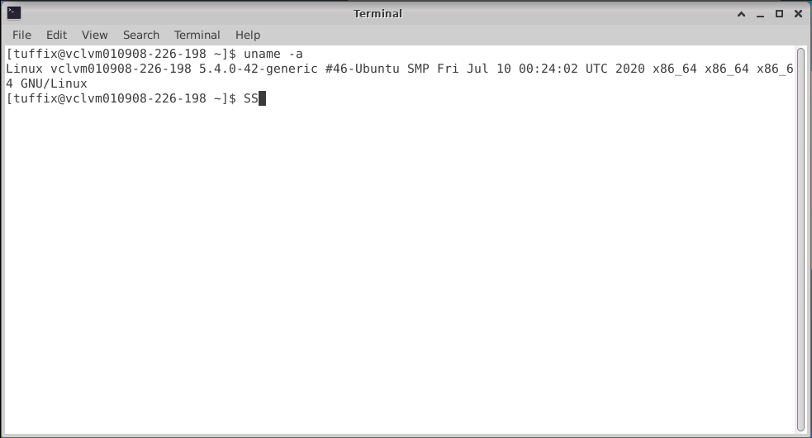
b. Input "uname -a" to check the system. The message shows the system is "x86_64 GNU/Linux".

Slide 16
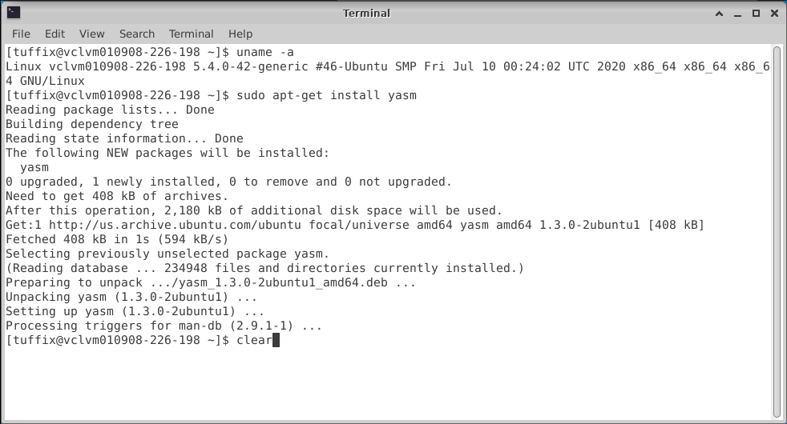
c. Input the "sudo apt-get install yasm" command to install "yasm" assembler. Input "clear" command to clear the window.

Slide 17
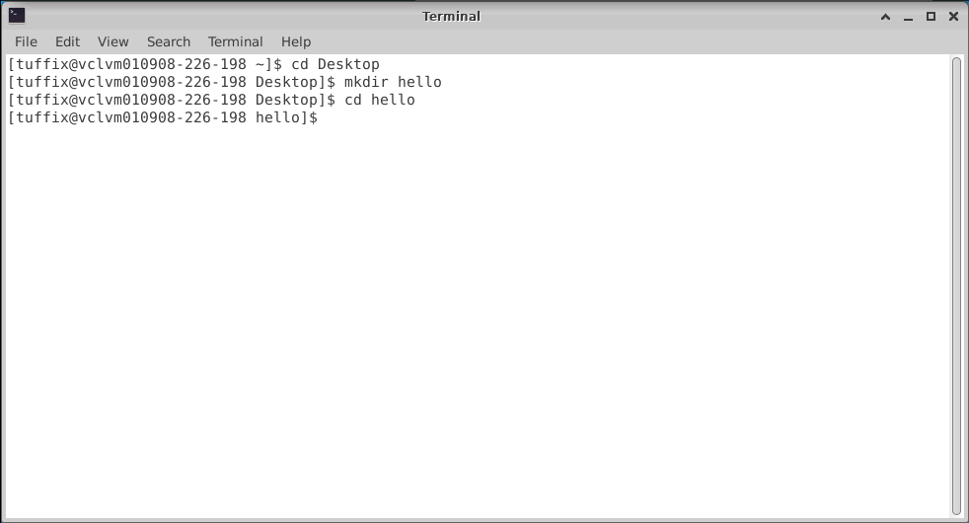
d. Input "cd Desktop" to change directory to "Desktop". Input "mkdir hello" to create "hello" folder. Input "cd hello" to change directory to "Desktop/hello".

Slide 18
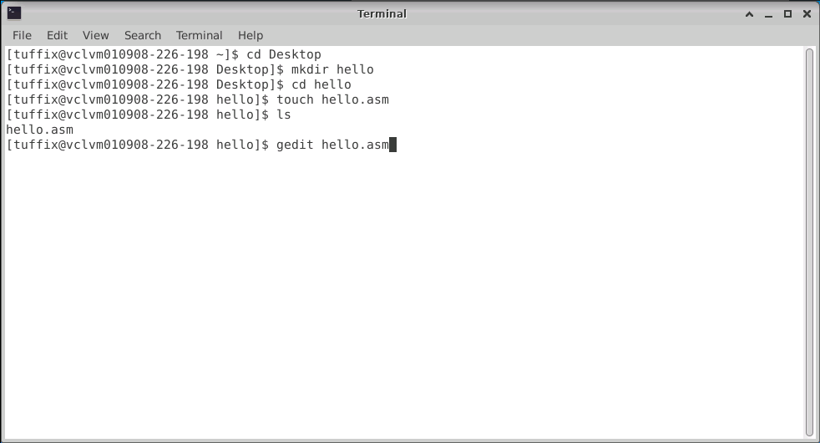
d. Input "touch hello.asm" to create "hello.asm" file. Input "ls" to show the file in the "hello" folder. Input "gedit hello.asm" to edit "hello.asm" file.

Slide 19
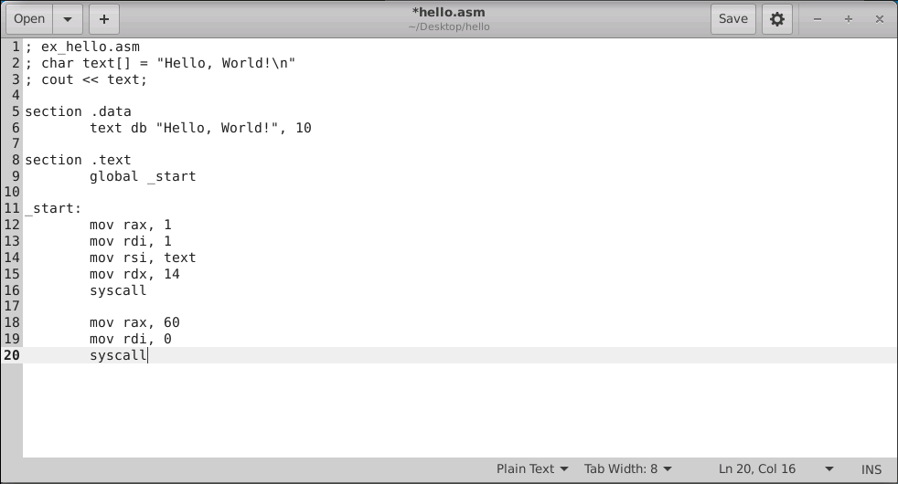
e. Input the program as follows: Click "Save" button to save the program to "hello.asm". Click "X" to return to "Terminal Emulator".

Slide 20
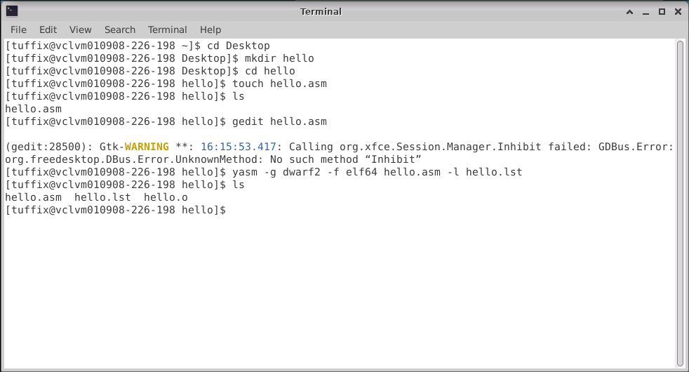
f. Input "yasm -g dwarf2 -f elf64 hello.asm -l hello.lst" command to run the assembler and generate "hello.lst" and "hello.o" files. Input "ls" to check the directory.

Slide 21
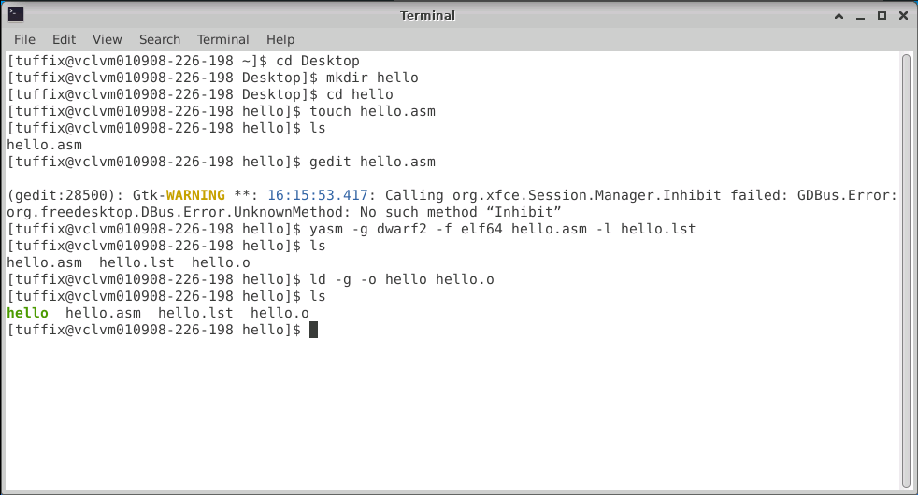
g. Input "ld -g -o hello hello.o" command to run the linker and generate "hello" files. Input "ls" to check the "Desktop" directory.

Slide 22
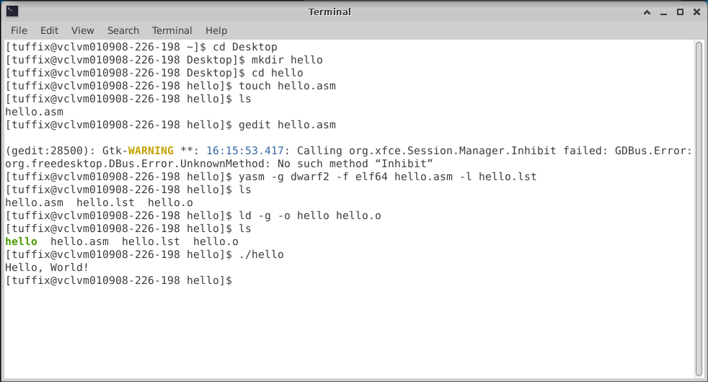
h. Input "./hello" command to execute the "hello" file and display the execution result of "hello, World!".

Slide 23
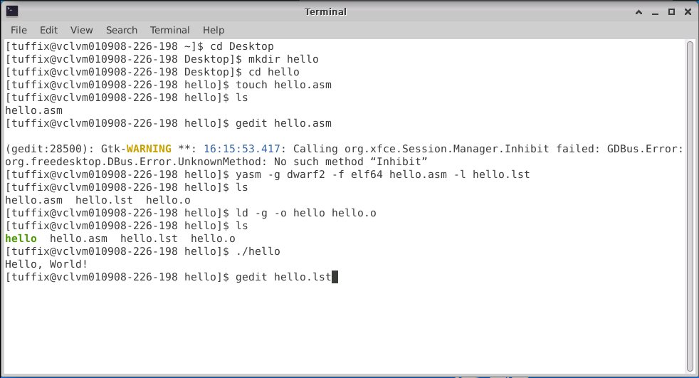
i. Input "nano hello.lst" command to open "hello.lst" file.

Slide 24
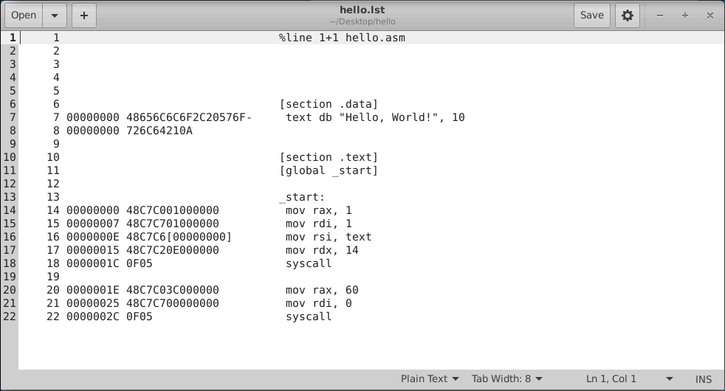
j. The GNU nano will display the "hello.lst" file. Click "X" to return to "Terminal Emulator".

Slide 25
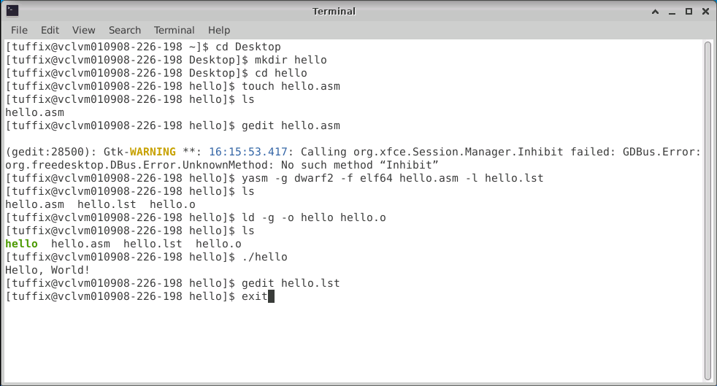
k. Input "exit" to close the "Terminal Emulator" and return to the "Desktop".

Slide 26
Upload Program

Slide 27
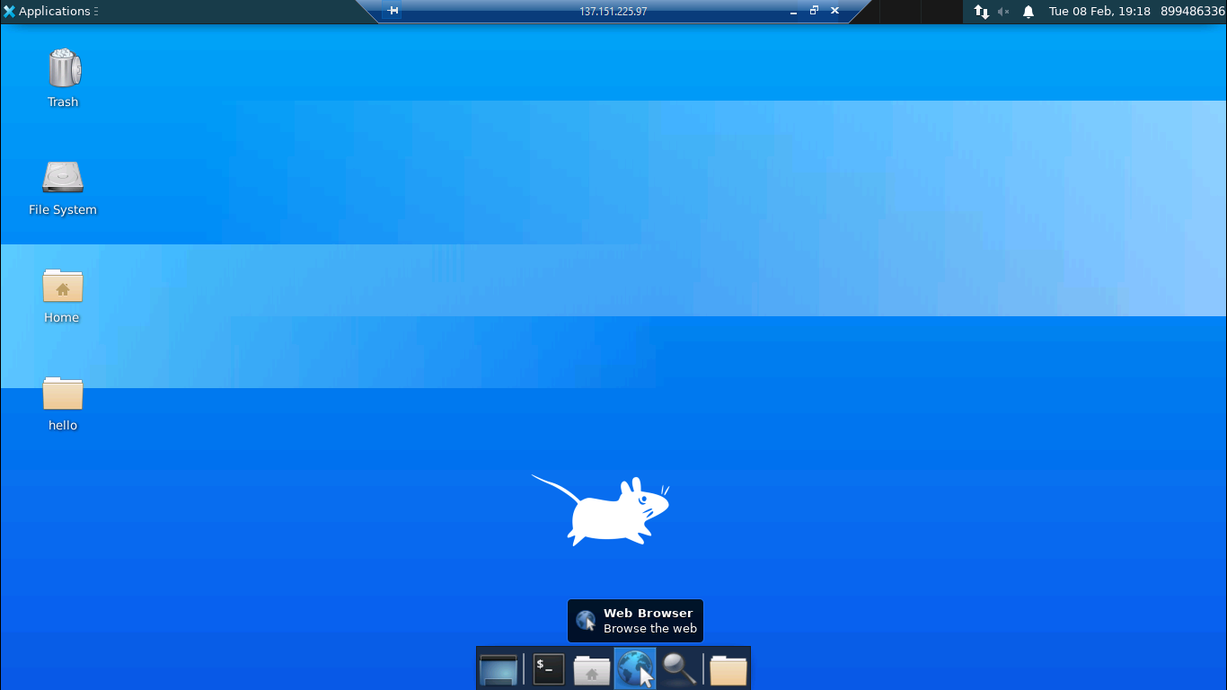
a. Switch to "Desktop" and click on "Web Browser" to open "Web Browser".

Slide 28
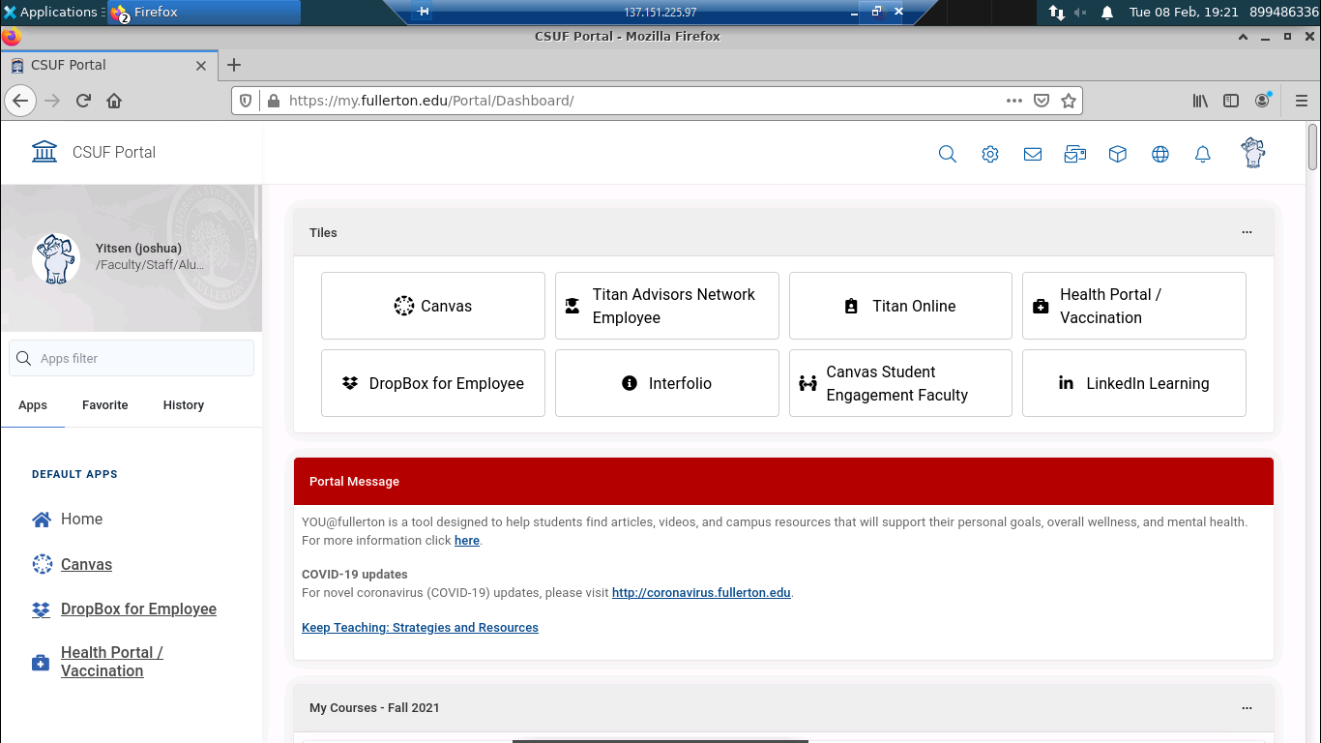
b. Open "CSUF portal" and click on the "DropBox"

Slide 29
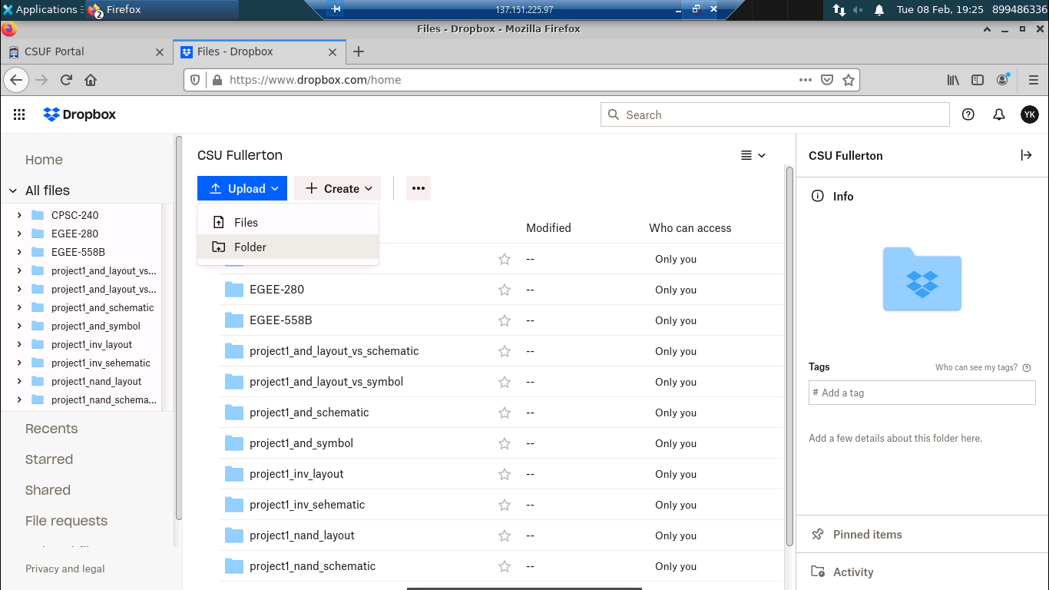
c. Click the "Upload/folder" on the Dropbox page

Slide 30
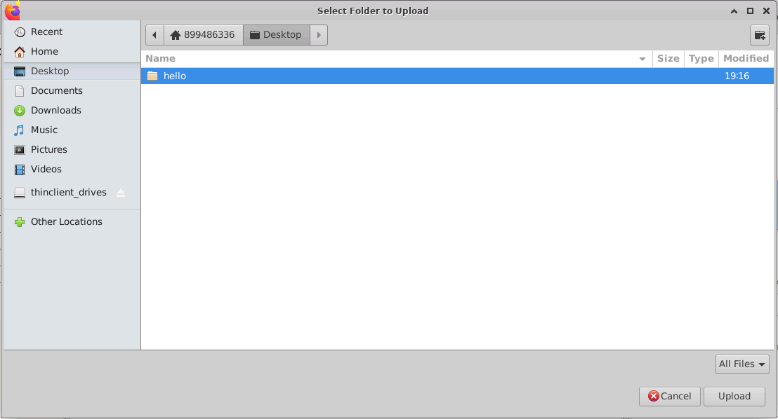
d. Select the "hello" folder on the Desktop and click the "Upload" button to continue...

Slide 31
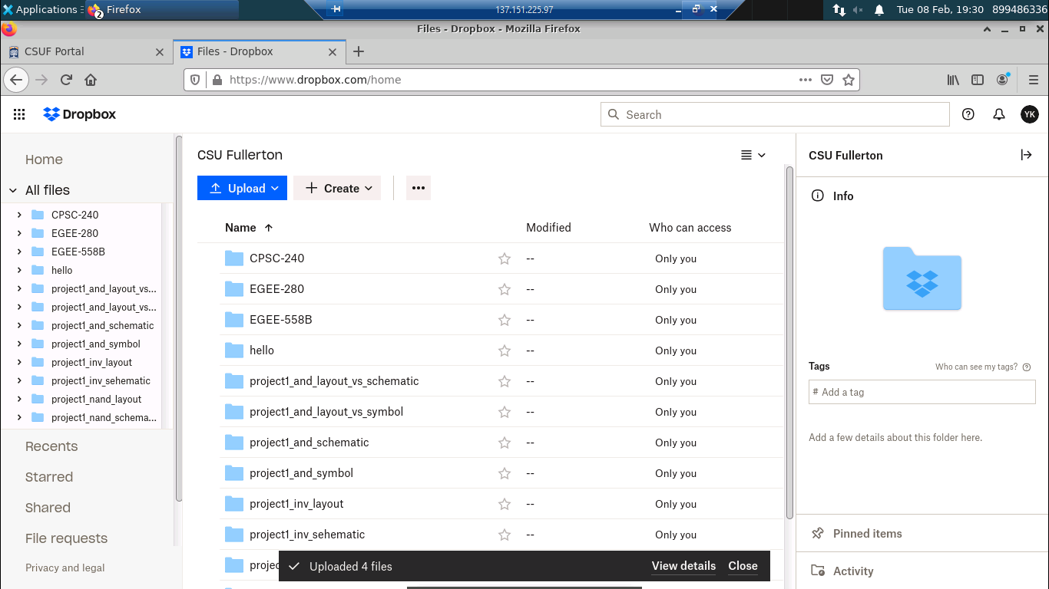
e. The "hello" folder has been uploaded to Dropbox.

Slide 32
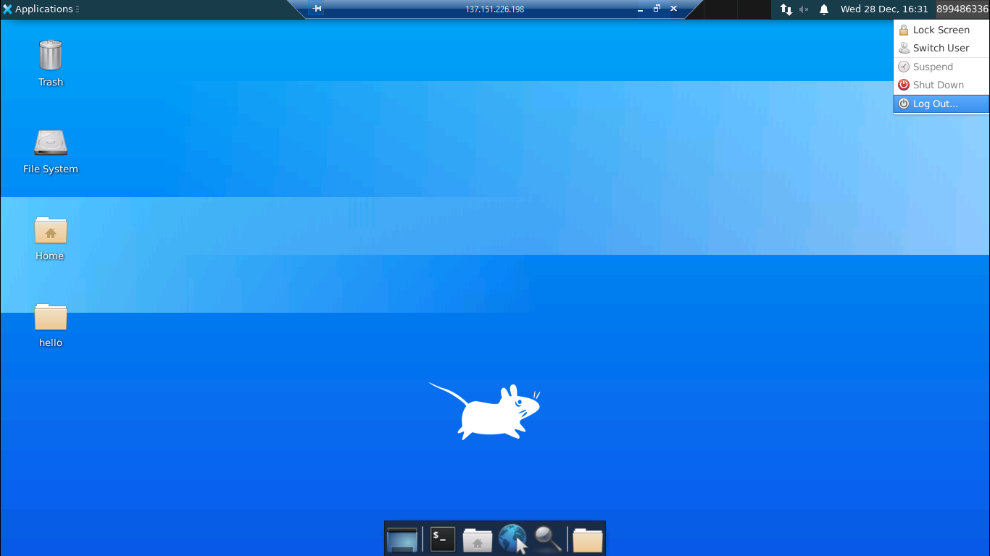
l. Click the "CWID" and select "Log Out…" to terminate the "Remote Desktop" connection and free up bandwidth for other students to use.

Slide 33
Thanks

